Slide 1
Digital Portfolio
STUDENT NAME:
REGISTER NO AND NMID:
DEPARTMENT:
COLLEGE: COLLEGE/ UNIVERSITY

Slide 2
PROJECT TITLE
Digital Portfolio

Slide 3


AGENDA
Problem Statement
Project Overview
End Users
Tools and Technologies
Portfolio design and Layout
Features and Functionality
Results and Screenshots
Conclusion
Github Link
3/21/2024 Annual Review

Slide 4

PROBLEM STATEMENT
In today’s digital-first world, traditional resumes and paper portfolios are no longer sufficient to showcase an individual’s skills and achievements effectively. Employers, educators, and collaborators prefer interactive and accessible platforms to evaluate candidates. A digital portfolio bridges this gap by providing a professional online presence, showcasing technical skills, academic achievements, certifications, and projects in a structured, visually appealing manner.

Slide 5

PROJECT OVERVIEW
The Digital Portfolio is a personal website designed to represent professional and academic information in an engaging and organized way. It allows the user to highlight skills, educational background, projects, and certifications while offering a modern, responsive, and user-friendly interface. The portfolio serves as a self-branding tool to attract opportunities in education, internships, and employment

Slide 6

WHO ARE THE END USERS?
Students – to showcase their academic achievements and skills.
Job Seekers – to present projects and resumes in a digital format.
Recruiters/Employers – to evaluate candidates beyond a traditional CV.
Peers and Collaborators – to discover shared interests and potential partnerships.

Slide 7

TOOLS AND TECHNIQUES
Tools and Technologies
Frontend: HTML5, CSS3, JavaScript
Styling Framework: Inline CSS
Icons & Fonts: Google Fonts, Font Awesome
Version Control: Git & GitHub

Slide 8
POTFOLIO DESIGN AND LAYOUT
Theme: Modern, clean, and responsive design (light/dark mode optional).
Navigation Bar: Home, About, Education, Skills, Projects, Certificates, Contact.
Hero Section: Name, tagline, and call-to-action (Download Resume, Contact).
About Section: Professional introduction with photo.
Projects Section: Grid-based project cards with descriptions and links.
Certificates Section: Image-based showcase with hover details.
Contact Section: Email, social links, and a simple contact form.
Footer: Copyright, social icons, and quick navigation.
8

Slide 9
FEATURES AND FUNCTIONALITY
Fully responsive design for desktop, tablet, and mobile.
Resume download option (PDF format).
Portfolio showcase with project links and GitHub repositories.
Certificates gallery with zoom/preview.
Interactive animations (fade-in, hover effects).
SEO-friendly structure for better visibility.
Direct contact links (email, LinkedIn, GitHub).

Slide 10
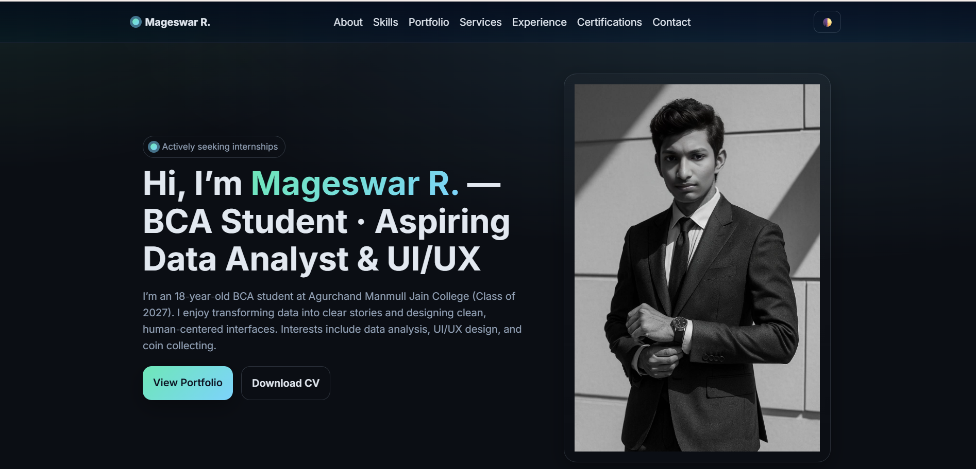

RESULTS AND SCREENSHOTS
A functional, visually appealing portfolio hosted online.
Clear navigation and easy access to professional details.
(Insert screenshots of Home, Projects, Certificates, and Contact pages here).
3/21/2024 Annual Review
10

Slide 11
CONCLUSION
The Digital Portfolio successfully addresses the need for a modern professional presence by offering a dynamic, user-friendly platform to present academic and professional details. It enhances employability by making skills, projects, and achievements easily accessible to recruiters and collaborators. The project demonstrates technical skills in web development and showcases personal branding effectively.
GitHub Link:
https://github.com/Mageswar13/portfolio1
11

